Slide 1





Digital Initiatives – September 2024
Be Smart, Bank Smart
UPI
transactions
Mobile banking transactions*
Mobile App ratings
Digital Journeys launched
2.28 Cr/day
Remitter – 1.55 Cr
Beneficiary – 0.73 Cr
28 Crores/month
4.1
102
(74 Journeys / 28 processes & portals)
* FT + NFT

Slide 2
Digital Migration
Branch transactions Vs Digital transactions
Digital Transactions
Manual Transactions

Slide 3
Digital Banking
In lakhs
Mobile Banking
UPI

Slide 4
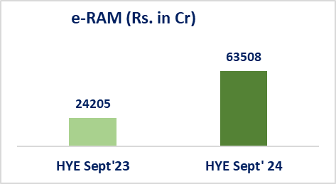
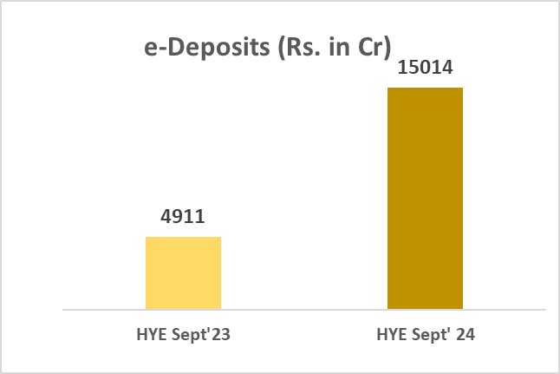
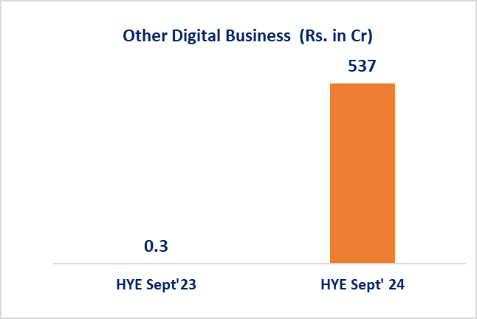
Digital Initiatives
102 Digital Journeys
Retail – 36
Agri -16
MSME -18
Deposits -2
Insurance/Supply Chain Finance – 2
Other Processes & Portals - 28
Digital journeys / Processes launched in FY 2024 : 78
(Journeys – 57; Processes/ portals: 21)
Digital Business in FY 2024 – Rs.81250 Cr
Digital journeys/processes prioritized in FY 2024-25: 56
Out of which, launched - 24
Launched in Q1 : 6
Launched in Q2: 18
Planned in Q3: 13
Planned in Q4 : 19
Digital business
₹79059 Cr
Digital Business H1 FY 24: Rs. 29116 Cr
172% (y-o-y)
Digital Business H1 FY 25: Rs. 79059 Cr
e Business (in Cr)
*
Digital Adoption Rate (Sep’ 24)
162%
206%
Retail – 73%
Agri – 91%
MSME – 77%
* Includes e-BG, e-OTS

Slide 5
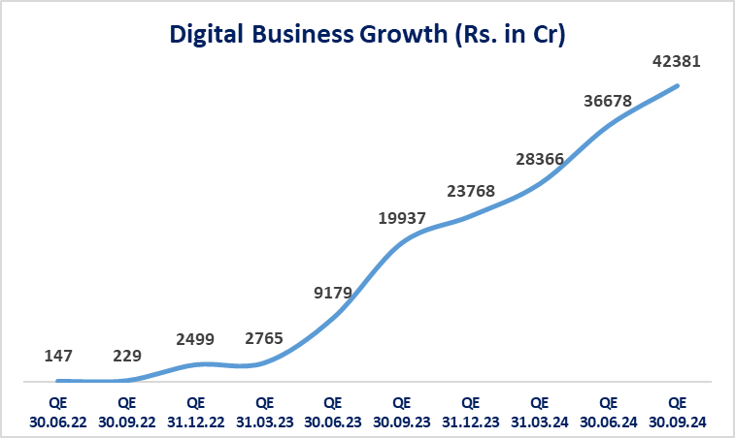
Digital Initiatives
Cumulative Digital Business: Rs. 1.66 lakh Cr till 30th Sept 2024

Slide 6
Digital Products – FY’25
Digital journeys launched
17
Digital journeys planned to be launched
39
Planned for Q3 – FY 2024-25
11
in Q1- FY 2024-25 -- 4
PM Vishwakarma Ind Digi (BRE Journey)
MSME Renewal MSME Auto renewal
Cluster Loan
MSME Contractor
IND Digi Express
Personal Loan
One Card
HL – Repair and Renovate
PM Swanidhi
Staff OD |  | ✓
HL Plot |  | ✓
KCC Dairy |  | ✓
GST Sahay |  | ✓
Planned for Q4 – FY 2024-25
16
in Q2- FY 2024-25 -- 13
HL Plus
HL Enrich
Vehicle Loan used
Two Wheeler Loan
Loan against NSC, KVP
HL improve
Staff Housing Loan
Staff Vehicle Loan
IND Mortgage
Govt. sponsored schemes
Home Loan Flexi
IB Rental
IB Rental Encash
GST advantage with security
Doctor Plus GST Advantage with Partnership
Education Loan : Variants (5) | ✓
Rooftop Solar Loan | ✓
Retail JL (Modification - 3/6 months) | ✓
KCC Gold Plus | ✓
KCC Marine Gold | ✓
GST Advantage Renewal | ✓
MSME General | ✓
MSME Secure | ✓
MSME Lap | ✓
Other products – FY 2024-25
12
Co-lending platform – partnership (1)
Corporate Credit platform – 3
Cash Management Services – 6 Digital Insurance Platform - 2

Slide 7
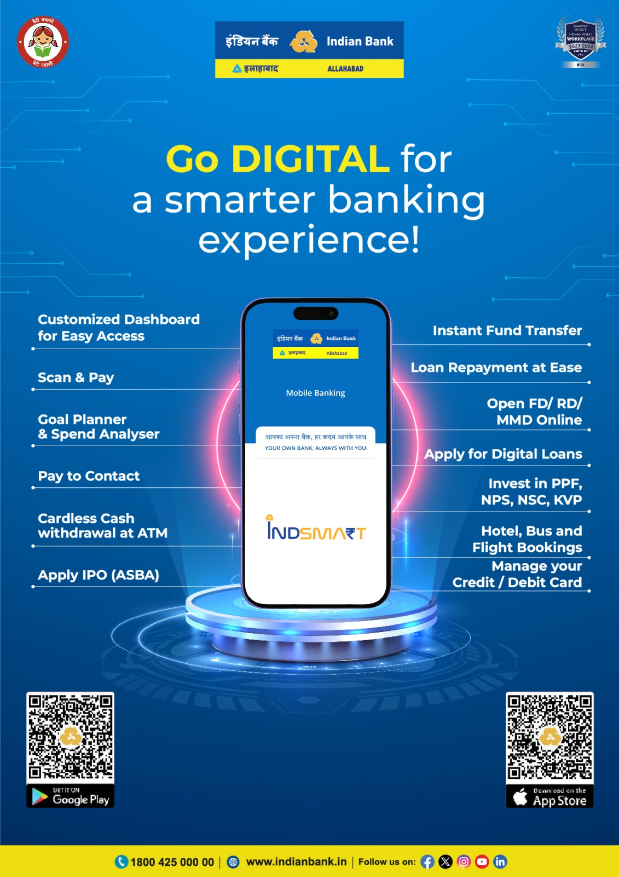
Be Smart, Bank Smart
Platform live since 24.06.2024.
Available in Google Play store & Apple App store for customers.
App store rating: 4.1
37 lakh+ customers on boarded
Corporate Mobile Banking live under CUG

Slide 8
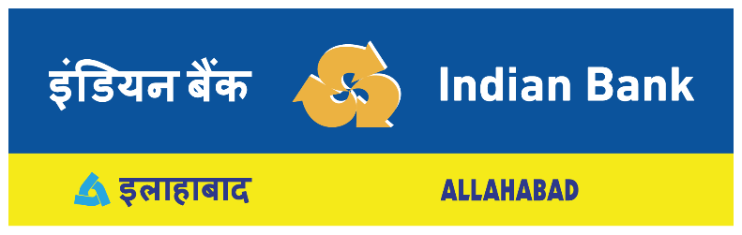
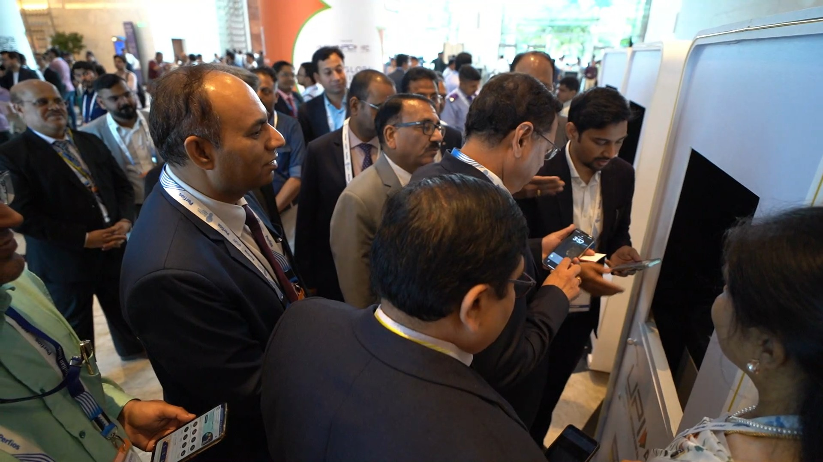
Digital Business & Fintech Partnership
136 Fintechs empaneled for providing Software Applications / Solutions and support services:
Digital Journeys solutions provider
  Digital Solution for emerging products and Banking process automation
  Forex Solutions
  Merchant Solution Provider
  Omnibus Workflow solutions provider
  Beyond Banking Solution Provider
Fintech Solutions Offered
SNA Solution
Mobile App for Apartment Society Management
DBT Platform
Solutions to Municipal Corporations
Religious Institution Management
CESS Collection Portal
IB SUGAM: Bulk Payment Management System
Coaching Management Solution
E-Governance solution for eProcurement, eTendering & eAuction system etc
POS, Dynamic QR
Salary solution
Ind Pension: e-PPO Generation
eRupi
Hostel Management Solution
API Banking
Web based GPF Solution
Products launched at Global Fintech Fest 2024:
Delegate Payments through UPI
Interoperable Cash Deposit (ICD) through UPI in BNAs.
Android Digital Banking Unit - DBU Service using Android BNA

Slide 9








Ongoing Key projects
  Digital Lending: 74 journeys completed
  More than 25 journeys such as, Personal loan, PMVishwakarma, Ind Digi Express, One card etc are in pipeline for implementation
  4 Way Data Centre:
  DC, Near DC, DR, Near DR
  For having Zero Data loss while operating from DC or DR
  Omnichannel Corporate Mobile app and Internet banking: Dedicated mobile app to Corporate & MSMEs designed to meet their banking requirements. Currently under CUG.
  Cash Management Services:
  For optimizing cash flow for effective management of business operation;
  RBIH- Unified Lending Interface (ULI):
  RBiH’s ULI integration with Digital journeys for efficiency in the lending process in terms of reduction of costs, quicker disbursement, and scalability. More than ₹ 550 Cr. of digital business done through RBIH ULI.
  Next Gen Call Centers:
  Contact Center-as-a-Service (CCaaS): To take customer experience to the next level empowered by Intelligent Virtual Assistants.
  Mobile APP for RM:
  Personalized Banking experience to customers by mapping RMs with HNI customers
  Employee Assist:
  A Conversational Gen AI Chatbot solution tailored for our bank's field personnel, providing quick and efficient access to all relevant information and support for our digital products

Slide 10
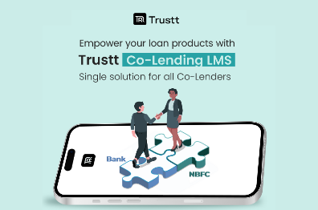


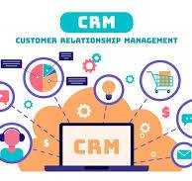



Ongoing Key projects
  Digital Co-Lending Pool Buyout platform:
  Partnering with NBFCs to boost priority sector lending through digital platform
  Cloud migration:
  Digital Lending Platform upgrade to Micro services enabled on-prem cloud services. Highly scalable, lower costs, faster and more reliable performance.
  Generative AI :
  Partnership with RBiH - Automated grievance redressal system;
  Chatbot solution for quick and efficient access to all relevant information and support
  Data Analytical Models:
  Spend Analytics, Customer Life time value
  CRM solution:
  Boost new customer acquisition and retention of existing customers
  360-degree view of customer profile
  Robust Lead Management System with end-to-end tracking of customer life cycle
  Digital Insurance Platform:
  Aggregator for all insurance companies. Motor insurance journeys launched on 15.08.2024. 10+ journeys under commercial vehicle & health insurance products are planned for delivery during Q3-FY’25
Data Lake:
Centralized repository
Holistic approach to data analysis, governance, and security
  Software Defined with Wide area network (SDWAN):
  Aggregated network benefit for all locations

Slide 11


Ongoing Key projects
  Corporate credit:
  Automation of corporate credit proposal with pre-integrated public data sources. Effective data-based credit decisioning using structured and unstructured data from different digital sources to objectively determine credit worthiness of clients.
  Agri Stack - Digital foundation set up by the government to improve agriculture in India by using data and digital services . Bank will be on-boarded on Agri Stack in Q3

Slide 12
Thank You

